Slide 1

Assessing the Status of Gentrification in Metropolitan Areas in the United States
Tufts University | DATA-200
Vishwesh Srinivasan, Vanessa Venkataraman, and Hanzhen Wang

Slide 2
A
G
E
N
D
A
01
02
03
04
05
06
Introduction
Literature Review
Data Description
Our Hypothesis
Models and their Results
Conclusions and Future Work

Slide 3
Introduction
“Gentrification is the process by which central urban neighborhoods that have undergone disinvestments and economic decline experience a reversal, reinvestment, and the in-migration of a relatively well-off middle- and upper middle-class population.” - Neil Smith
Positives of Gentrification: increased investment, commercial development, increased property values, improvement in economic opportunity
Negatives of Gentrification: high rate of displacement in communities, higher housing costs, higher property taxes, forced relocation, community cultural changes, changes in businesses, dislocation
Gentrification disproportionately impacts low-income families and people of color.
In order to counteract the negative impacts of gentrification, it is important to recognize which neighborhoods are susceptible to gentrification and which communities are most vulnerable to displacement.

Slide 4
Literature Review
Kolko (2007) studied the determinants of gentrification using the Neighborhood Change Database. His research supported the fact that low-income city neighborhoods closer to the city center and with older housing stock witness higher income growth.
Kolko (2009), in another study, evaluated the effect of employment location on gentrification. His findings suggested that an increase in the mean neighborhood job pay influences the tract's income growth, by which he inferred that people follow jobs.
Boustan et al. (2019) studied if condominium structure led to gentrification in central cities. They did not see a statistically significant association between the condo density and the typical characteristics of gentrified regions – income levels and education.
Rucks-Ahidiana (2021) studied the effect of racial composition on the way gentrification happens in a community. He found that the gentrifying tracts with residents of color, compared to tracts with white people, display more characteristics of poverty.

Slide 5
Literature Review
Rigolon & Németh (2019) took a broad approach and considered the effect of three different categories of variables – people, place, and policy on gentrification.
They used the criteria given by Chapple et al. (2017) to identify the areas susceptible to gentrification in 2000. Then they again used the definition Chapple et al. (2017) gave to identify the areas that had actually been gentrified in 2015.
Finally, they tested how all the variables they had selected in the three categories for their model are beneficial in predicting whether a gentrification susceptible region will get gentrified or not.
They tested their model in five Combined Statistical Areas (CSAs). These CSAs are Chicago, Los Angeles, New York, San Francisco, and Washington, DC.
Their research showed that all three categories assist in predicting the probability of gentrification of the tracts. Some of the significant factors were: race, distance from downtown, units older than 30 years and population density.

Slide 6
Data Description - Neighborhood Change Database (NCDB)
Census tracts are locally determined geographic units, typically including between 2,500 and 8,000 persons. Tracts are meant to approximate "neighborhoods" by capturing a group of residents with similar social characteristics, economic status, and housing conditions.
A metropolitan area or metro is a region that consists of a densely populated urban agglomeration and its surrounding territories sharing industries, commercial areas, transport network, infrastructures and housing.
A metro area usually comprises multiple principal cities, jurisdictions and municipalities: neighborhoods, townships, boroughs, cities, towns, exurbs, suburbs, counties, districts, as well as even states and nations like the euro districts. As social, economic and political institutions have changed, metropolitan areas have become key economic and political regions.
A powerful feature of the NCDB is its ability to match tracts across all the five census years, enabling users to examine changing tract characteristics between 1970 and 2010.
Since the boundaries of many tracts change between the decennial censuses (either splitting into several tracts, merging with other tracts, or appearing for the first time), a methodology has been developed to link such tracts and their associated data to standard geographic boundaries.

Slide 7
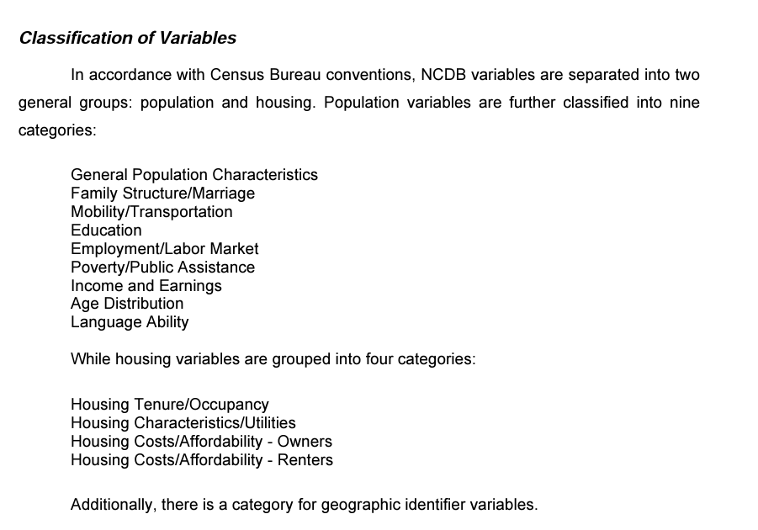
Data Description - Neighborhood Change Database (NCDB)

Slide 8

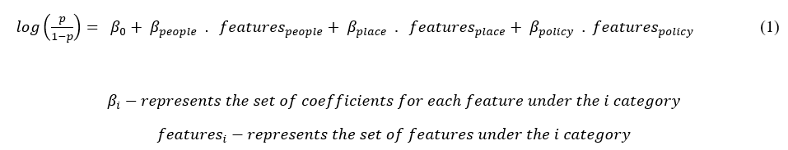
Our Hypothesis
PEOPLE
PLACE
POLICY
The three factors that contribute the most to determining if a neighborhood is susceptible to gentrification are…

Slide 9
Our Hypothesis - Model design and Output Variable (Y)
We selected the following two regions for our analysis:
New York-Northern New Jersey-Long Island, NY-NJ-PA Metropolitan Statistical Area (MSA)
Los Angeles-Long Beach-Santa Ana, CA Metropolitan Statistical Area (MSA)
We choose to study the process of gentrification between the years 2000 and 2010. To do so, we use different variables from the year 2000 as predictors (X) and create the labels (Y) as ‘Gentrified’ (1) or ‘Not Gentrified’ (0).
We use the following definition to identify if a tract is gentrified or not in the year 2010:
Change in median household income > Change in MSA median
Change in % college educated > Change in MSA percentage
Change in median gross rent > Change in MSA median
(OR)
% Increase of home value > % increase in MSA median
(Change between the year 2000 and 2010. Given by Rigolon & Németh (2019), adapted by them from Chapple et al. (2017))

Slide 10
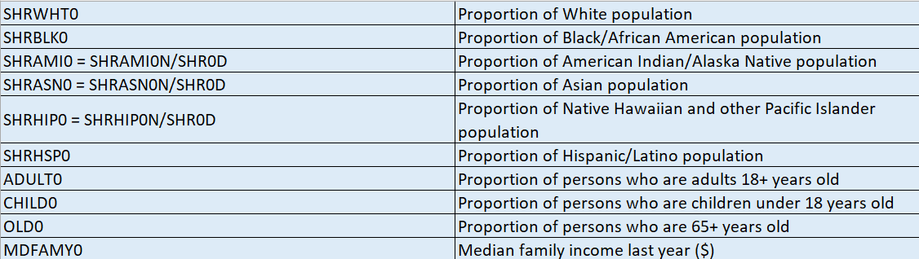
Our Hypothesis - Predictors (People)

Slide 11
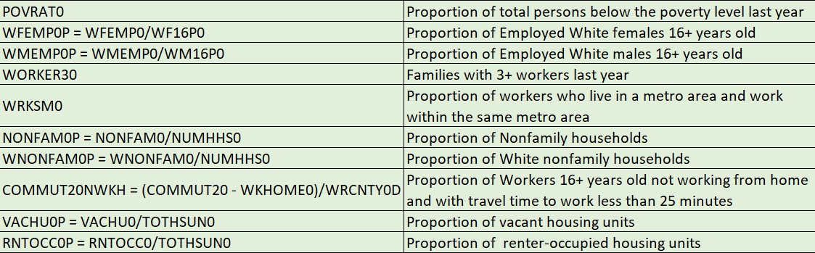
Our Hypothesis - Predictors (Place)

Slide 12
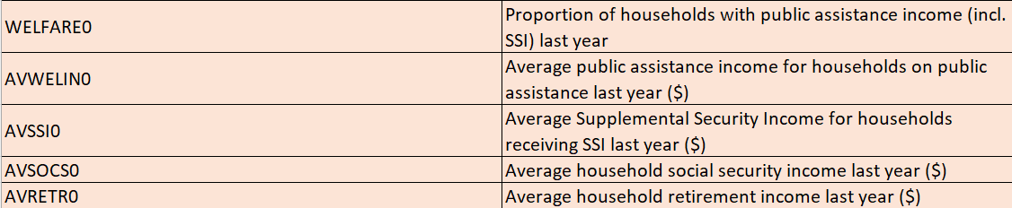
Our Hypothesis - Predictors (Policy)

Slide 13
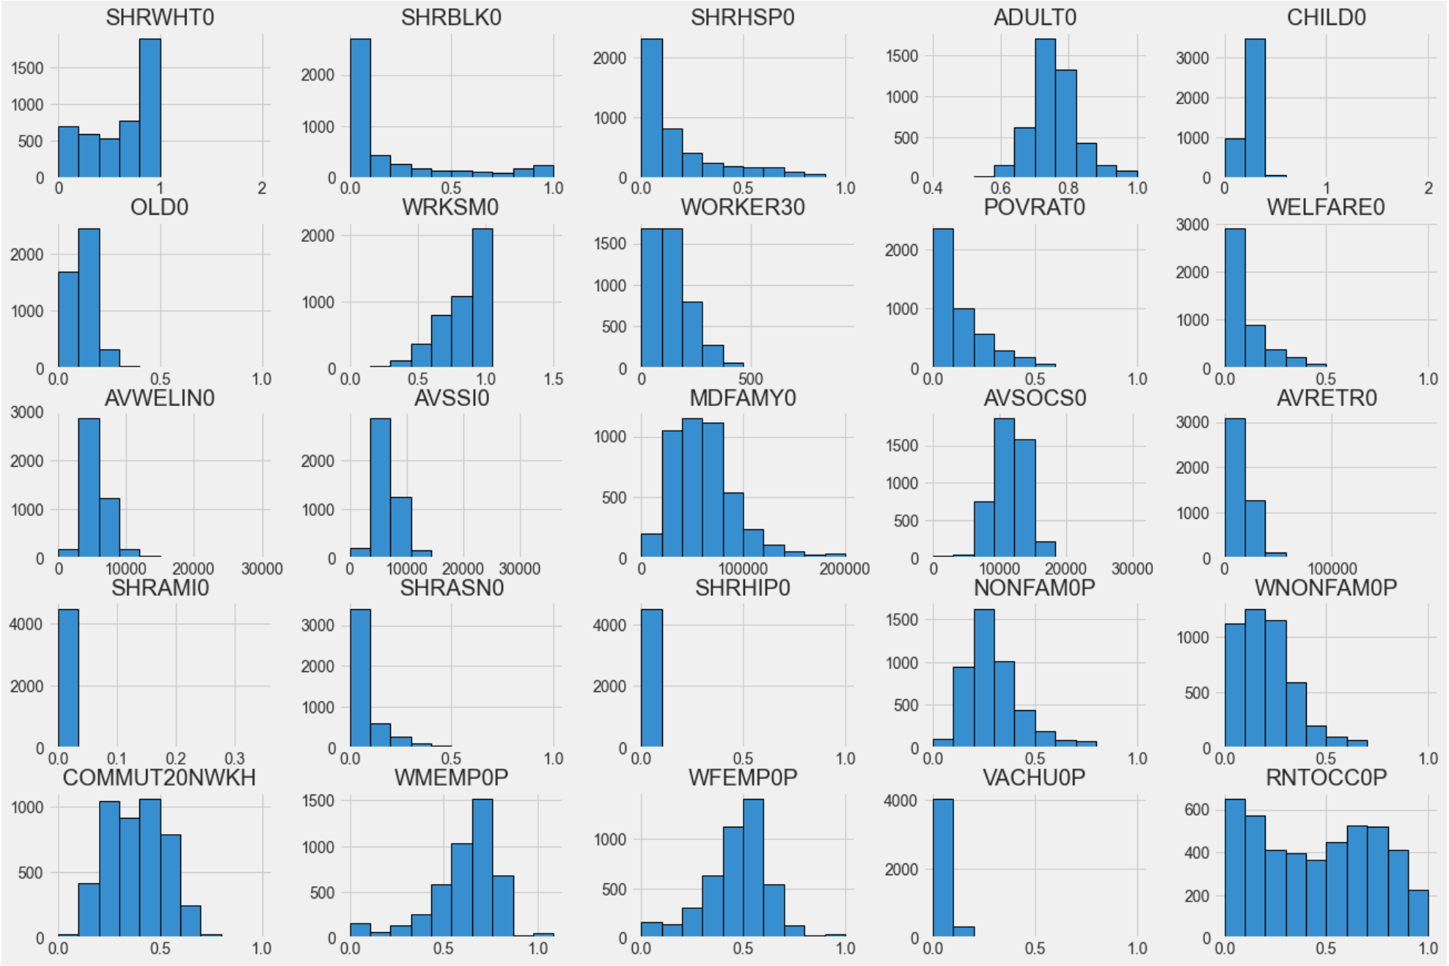
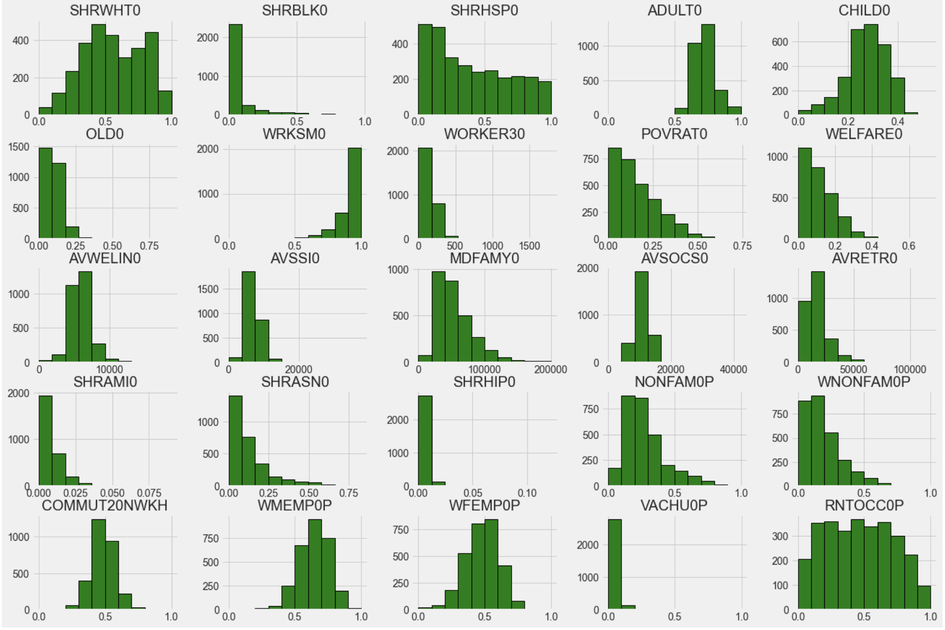
Data Visualizations
New York Metropolitan Area
Los Angeles Metropolitan Area

Slide 14
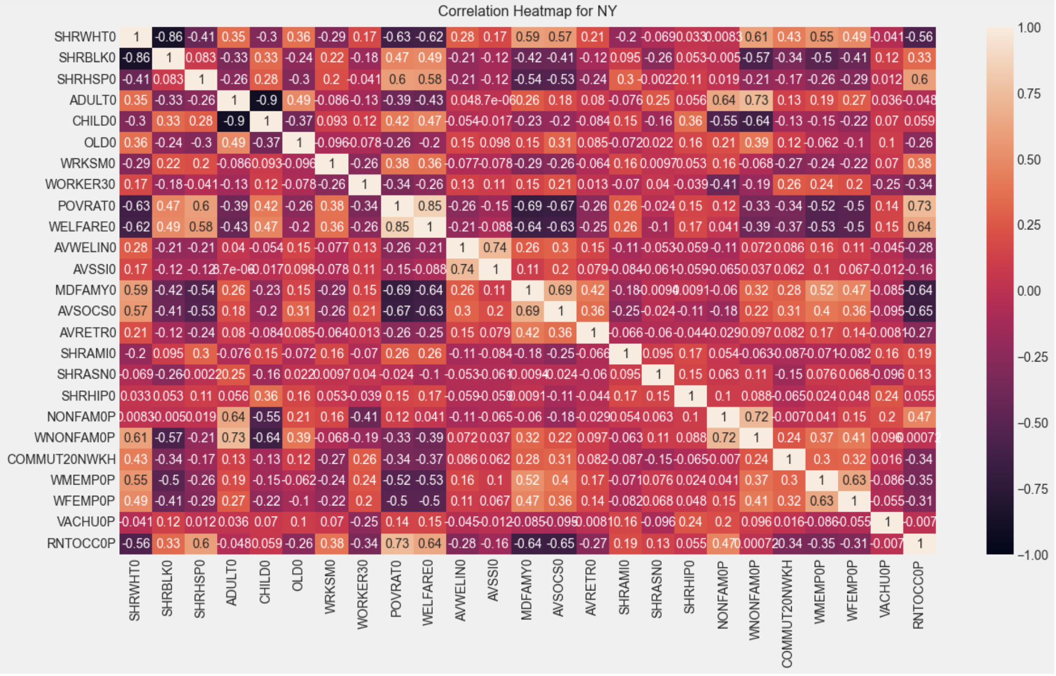

Slide 15
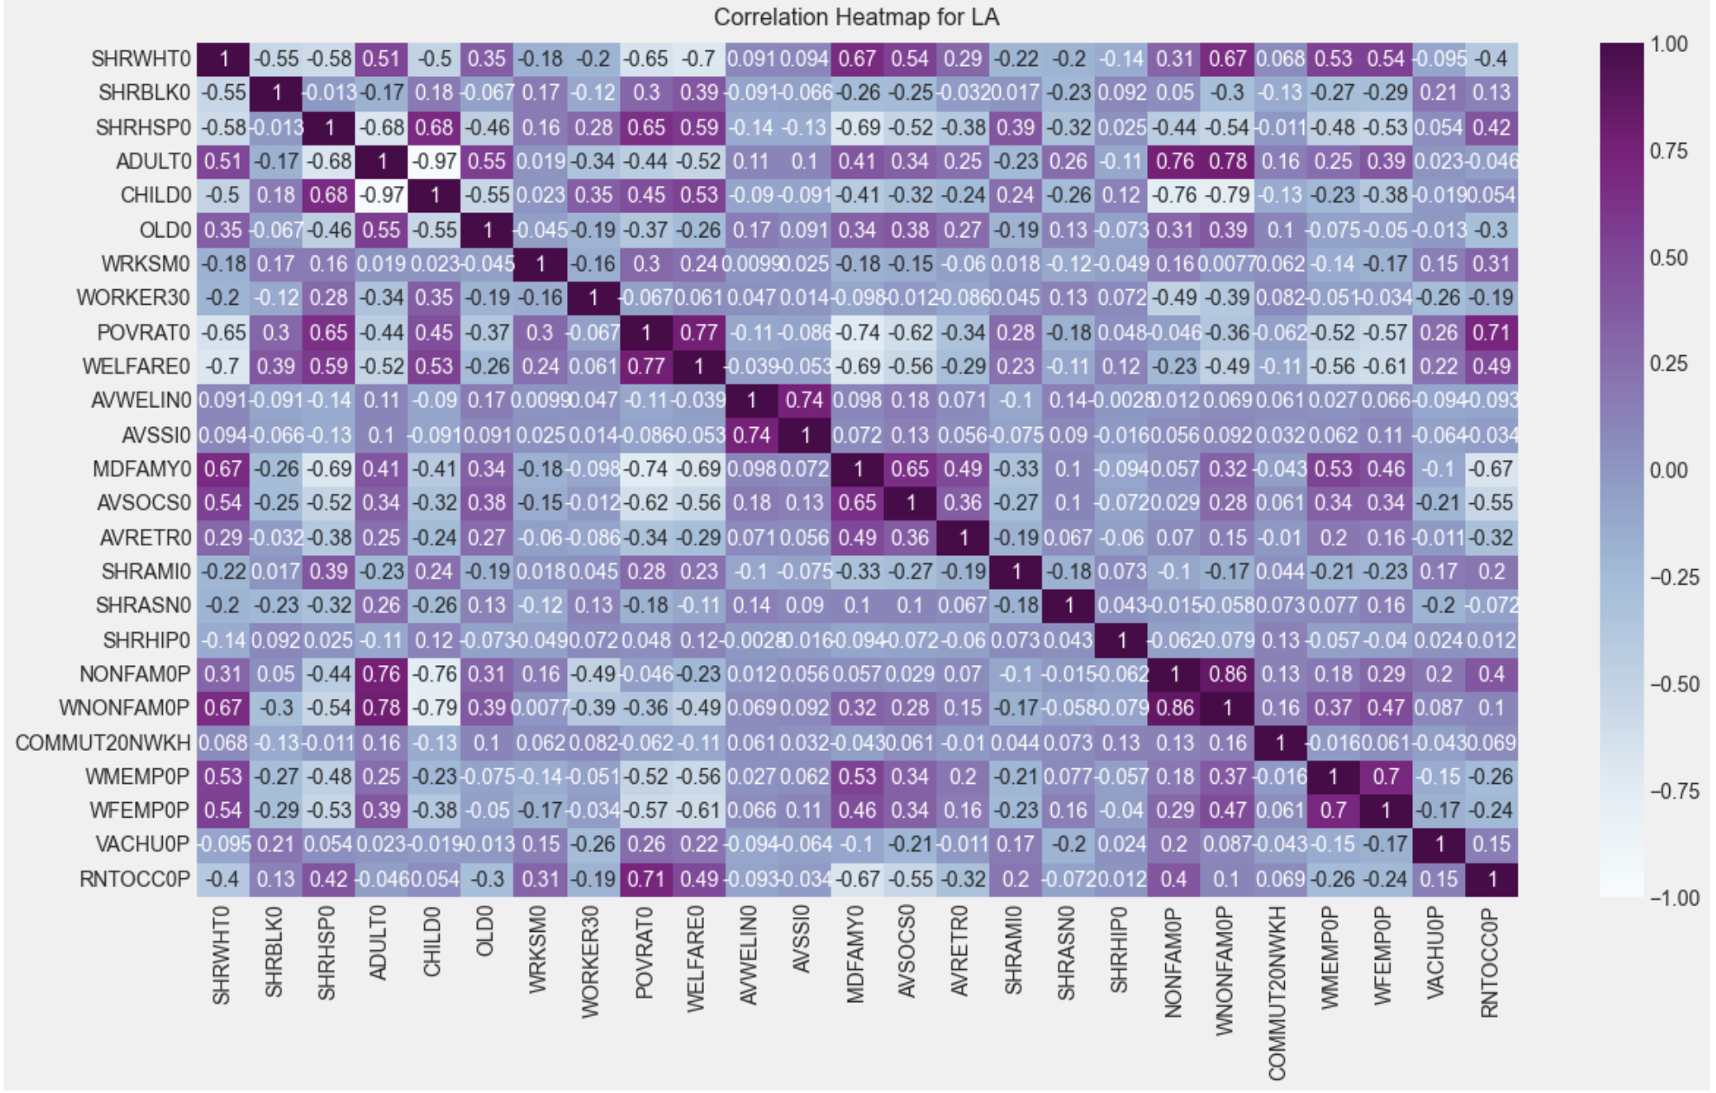

Slide 16
Models and their Results
Data Composition:
New York MSA: 990 tracts gentrified, 3522 tracts not gentrified
Los Angeles MSA: 583 tracts gentrified, 2343 tracts not gentrified
Modeling Process:
Normalized the variables which were not in proportions (for step 5)
Built a logistic regression model
Identified the significant variables out of all the predictors
Used the identified variables to build a random forest classifier
Used ADASYN (Adaptive Synthetic Sampling) technique to artificially generate more data of the minority class
Used the balanced dataset to build a random forest classifier
Compared the results obtained

Slide 17
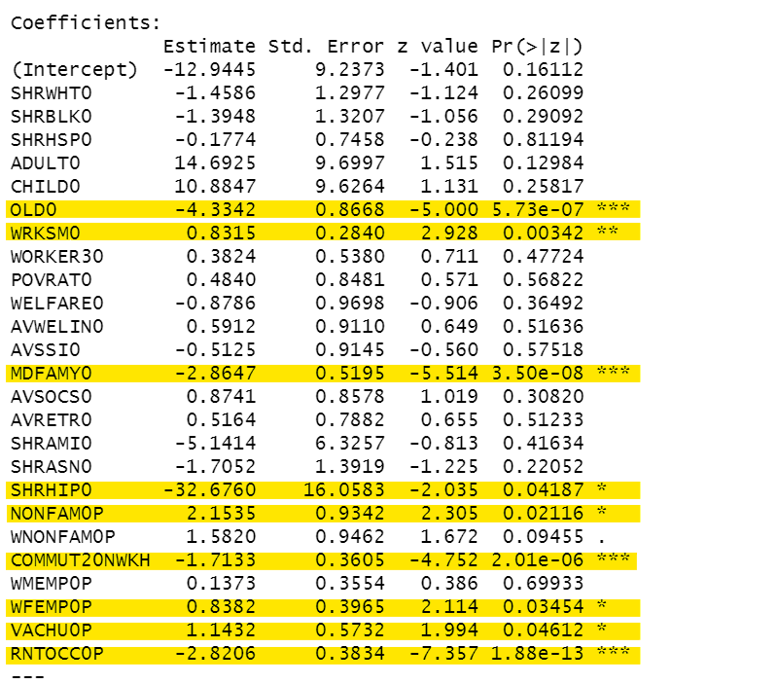
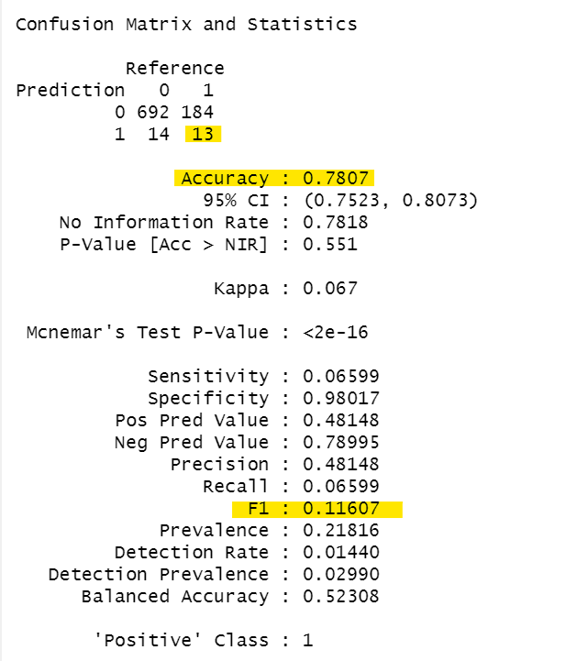
Models and their Results (New York MSA) - Logistic Regression Model

Slide 18
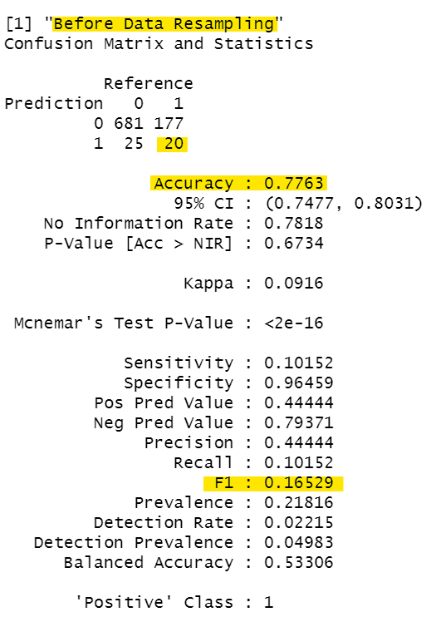
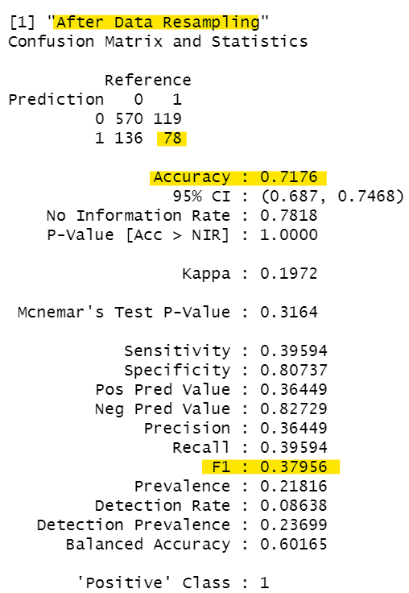
Models and their Results (New York MSA) - Random Forest Classifier

Slide 19
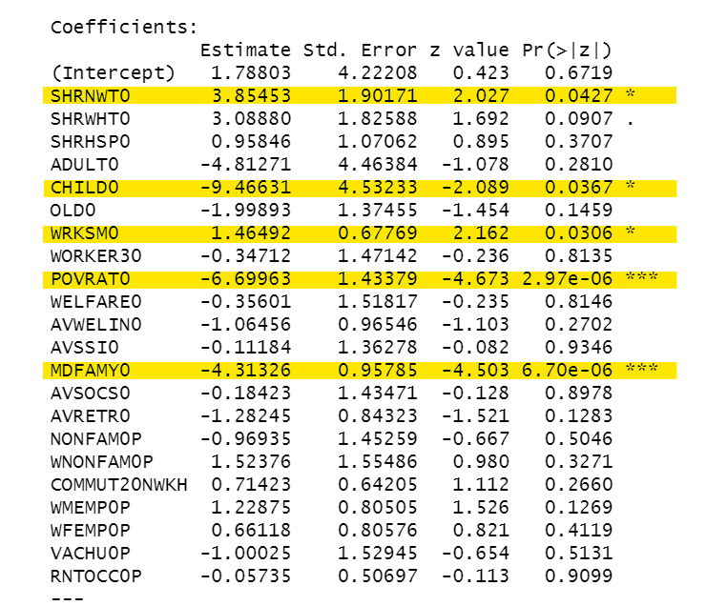
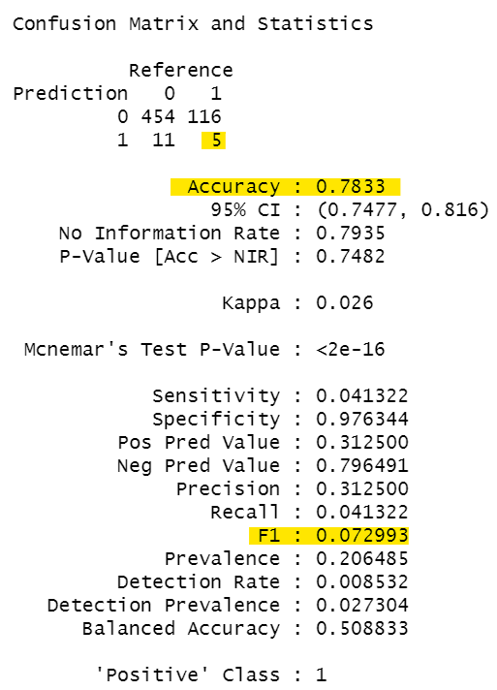
Models and their Results (Los Angeles MSA) - Logistic Regression Model

Slide 20
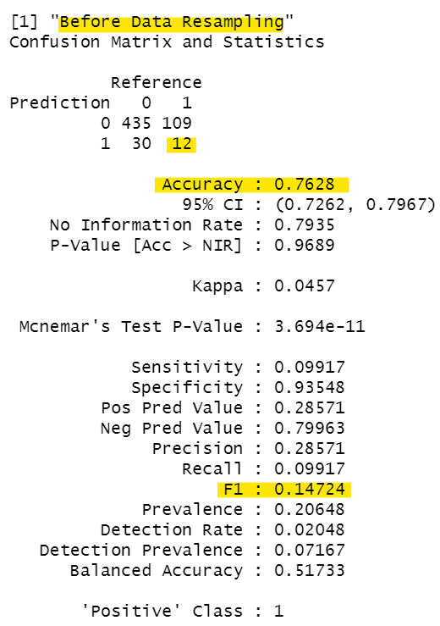
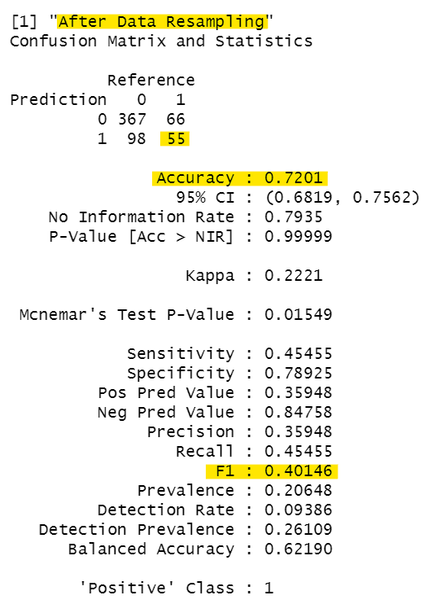
Models and their Results (Los Angeles MSA) - Random Forest Classifier

Slide 21
Conclusions
From the ‘People’ category, we find the following variables statistically significant:
We find ‘race’ to be a significant variable, in NY MSA, just the proportion of Native Hawaiian and other Pacific Islander population, whereas in LA MSA, along with this proportion of population, the proportion of Black, American Indians and Asians are also significant.
In NY MSA, we find the proportion of 65+ years significant whereas in LA MSA, we find the proportion of children under 18+ to be significant.
We find the ‘median family income’ to be significant for both the NY and LA MSAs.
From the ‘Place’ category, we find the following variables statistically significant:
We find the proportion of people living in the same metro area they are working in to be significant in both the NY and LA MSAs. In addition in NY MSA, we find that the proportion of people who travel less than 25 minutes daily to work also significant.
Notes:
NY only：
NONFAMO/NUMHHSO - Nonfamily HHs/Total Households - NONFAMO
WEMPO/WF16P0 - 16+ white female employed/total white female - WEMPOP
RNTOCCO/TOTHSUNO - Total Rent occupied housing units/total - RNIOCCOP

Slide 22
Conclusions
In LA MSA, the proportion of people under the poverty level also to be significant.
In NY MSA, variables like the proportion of Nonfamily households, proportion of employed white females, proportion of vacant and rented households are significant.
From the ‘Policy’ category, we do not find any of the variables that we considered to be statistically significant.
Notes:
NY only：
NONFAMO/NUMHHSO - Nonfamily HHs/Total Households - NONFAMO
WEMPO/WF16P0 - 16+ white female employed/total white female - WEMPOP
RNTOCCO/TOTHSUNO - Total Rent occupied housing units/total - RNIOCCOP

Slide 23
Future Work
To study the effect of other variables which we did not consider from the NCDB. These new variables could act as strong predictors and improve the classification model’s performance.
We have very limited variables pertaining to ‘Policy’ in the NCDB, hence we can explore other datasets which can give information about development programs and study their effect on the process of gentrification.
Instead of having a binary output variable - whether a region will get gentrified or not, we could possibly change the output variable to a ‘gentrification score,’ which represents the degree of gentrification.
Notes:
Those four aspect we are going to do more thinking and discussion

Slide 24

Q & A

Slide 25
Thank you!
Tufts University | DATA-200
Vishwesh Srinivasan, Vanessa Venkataraman, and Hanzhen Wang

